Slide 1
Abbreviated EIS Findings Mosle Recreation Area Lighting Improvement Project
Emily Bjorhus
Project Manager / Environmental Scientist
ebjorhus@princetonhydro.com
908-237-5660

Slide 2
Overview
Mosle Recreation Area Lighting Improvement Project
Removing 10 existing, portable, diesel-powered light towers located around the football / baseball fields
Installing 4 permanent LED light poles around the football field
Installing 6 permanent LED light poles around the gravel parking lot
Mendham Township Recreation Advisory Committee hired Princeton Hydro to prepared an abbreviated Environmental Impact Statement (EIS)
The EIS focuses on the project’s potential wildlife impacts

Slide 3
Existing Conditions
Notes:
Image Source: Google Earth

Slide 4
Notes:
Image Source: NJDEP GeoWeb

Slide 5
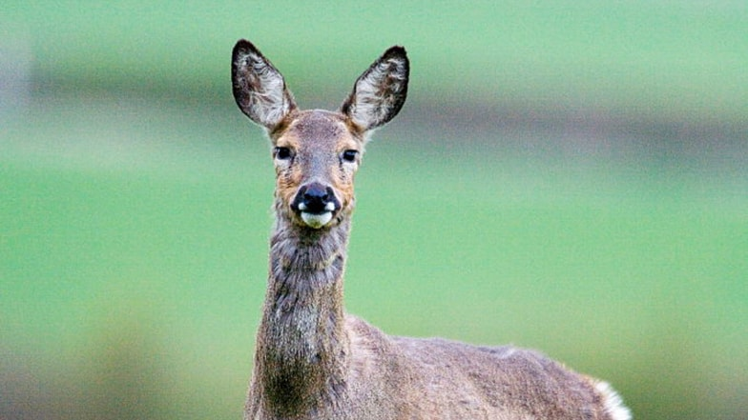
Existing Wildlife On-Site
White-tailed deer
Eastern gray squirrel
Eastern chipmunk
Groundhog
Coyote
Black bear
Notes:
Image Source: Google

Slide 6
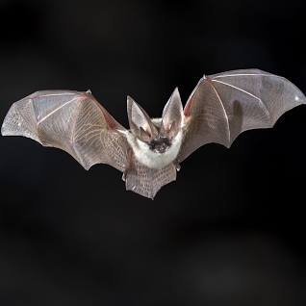
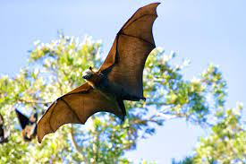
Threatened & Endangered Wildlife Mapped On-Site
Indiana bat (Myotis sodalist) active season sighting, maternity colony, roost site (Federally Endangered)
Northern long-eared bat (Myotis septentrionalis) active season sighting (Federally Endangered)
Tricolored bat (Perimyotis subflavus) (Proposed Federally Endangered)
Bog turtle (Glyptemys muhlenbergii) (Federally Threatened)
Monarch butterfly (Danaus plexippus) (Federal Candidate for Listing)
Bobcat (Lynx rufus) on road (State Endangered)
Barred owl (Strix varia) non-breeding (State Threatened)
Wood turtle (Glyptemys insculpta) occupied habitat (State Threatened)
Veery (Catharus fuscescens) breeding (SOSC)
Wood thrush (Hylocichla mustelina) breeding (SOSC)
Notes:
Top Photo: Indiana Bat
Bottom Photo: NLEB

Slide 7
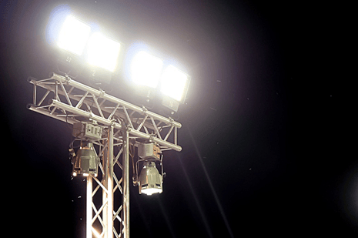
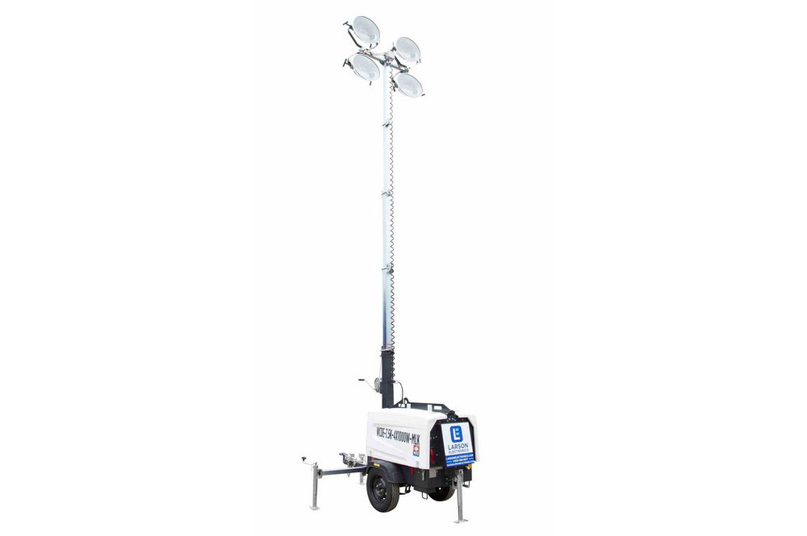
Existing Artificial Lighting Conditions
10 portable, diesel-powered, 25-foot-tall, high intensity discharge (HID) light towers
Used up to 3x/week at baseball and footfall fields
Used between September and November
No lights around the parking lot
Notes:
Left Photo: High-Intensity Discharge (HID) Metal Halide Lamps
Right Photo: Diesel-Powered Light Tower

Slide 8
Existing Lighting Program: Concerns
Safety
Noise and air pollution from diesel-powered generators
Lights near the end of their life
Lights not environmentally friendly
Lighting program not labor efficient
Current lights do not provide downlighting

Slide 9
Proposed Conditions
Goals of Project: Increase the usability and safety of the Site
Remove 10 existing, portable, diesel-powered light towers located around the football / baseball fields
Install 6 permanent, 30-foot-tall, 90-degree downstream, LED light poles around the gravel parking lot
Install 4 permanent, 60-foot-tall, 90-degree downstream, LED light poles around the football field
Notes:
Image Source: Musco Lighting Plan, dated April 23, 2024

Slide 10
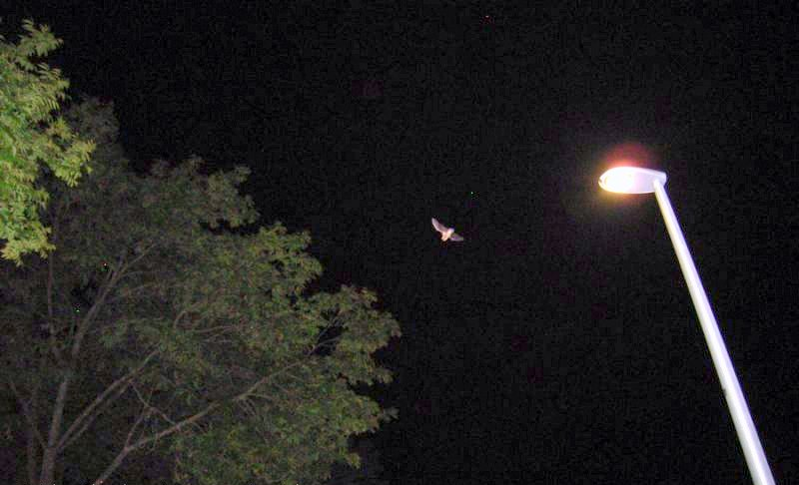
Potential Impacts of Artificial Light on Wildlife
Diurnal vs. Nocturnal
Some wildlife capitalize on the effects of artificial lighting while others are adversely impacted
Vacuum effect
Foraging opportunities
Habitat loss
Can affect circadian rhythms and a range of species interactions, physiological processes and behaviors
Notes:
Image Source: Google

Slide 11
Light Spectrum
HID lamps emit an abundance of UV light whereas LEDs have very few emissions in the UV range
UV wavelengths attract more insects and consequently more light-tolerant predators
HID attract more insects than LED
Several bat species are UV-sensitive and thus light averse
Converting HID lights to LEDs would reduce impacts of artificial light on wildlife
Notes:
Image Source: E.G. Rowse, et. al. (2016), Bats in the Anthropocene: Conservation of Bats in a Changing World, Chapter 7: Dark Matters: The Effects of Artificial Lighting on Bats. DOI 10.1007/978030319-25220-9_7.

Slide 12
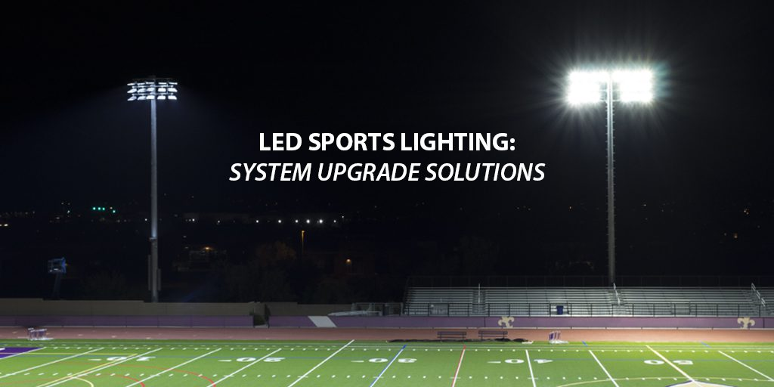
No Long-Term Adverse Impacts on Listed Species
Project has potential to benefit bats
May increase habitat range of light-averse species by reducing:
Light glare on surrounding forest
UV energy emitted from lighting
Potential to expand suitable bat roosting habitat and quality (darkness) of roosting habitat
May facilitate more even distribution of insects throughout Site
May increase insect availability in general community and decrease competition among light-averse species in dark areas
Notes:
Image Source: Musco

Slide 13
Impacts on General Wildlife
No Long-Term Adverse Impacts
Hours and months of light operation will not change
Wildlife will likely continue to avoid Mosle Field and parking area during lighting hours and return after people leave
Minor Long-Term Positive Impacts
Local wildlife will benefit from elimination of noise and air pollution from diesel-powered generators
Wildlife visibility around parking lot will improve so visitors can keep a safe distance if needed. This also keeps wildlife safe.
Short-Term Temporary Displacement During Construction

Slide 14
Emily Bjorhus
Project Manager / Environmental Scientist
Princeton Hydro, LLC
ebjorhus@princetonhydro.com
908-237-5660

