Slide 1
Mosle Field
Recreation Committee
Neighbors of Mosle Meeting
February 9, 2023

Slide 2
History
2019 – Upon my arrival in Mendham this was one of the first requests that came up at a facilities meeting
2020 – Pandemic put the plan on pause
2021 – Conversations restarted with the sports leagues
January 2022 – Meeting with sports leagues to discuss needs
March 2022 – Inclusion in Capital Budget to do a Site Study
April 2022 – Field Usage Survey Completed
October 2022 – TC approves moving forward with Site Study
January 2023 – Recreation Committee Delivers Proposal to Township Committee

Slide 3
Why Mosle
India Brook
We are looking to light for football and baseball. No baseball there. Plus installing irrigation at India Brook will be more expensive than at Mosle.
Ralston
Higher Number of homes affected – there is not natural division
Not enough parking
Wouldn’t light a football field. Ralston is used by soccer, not football. Having a well irrigated field is arguable more important for soccer than football
Meadowood/Mt. Pleasant/Wysong/Pitney
Infrastructure is not there
Middle School
This is a Board of Ed property

Slide 4
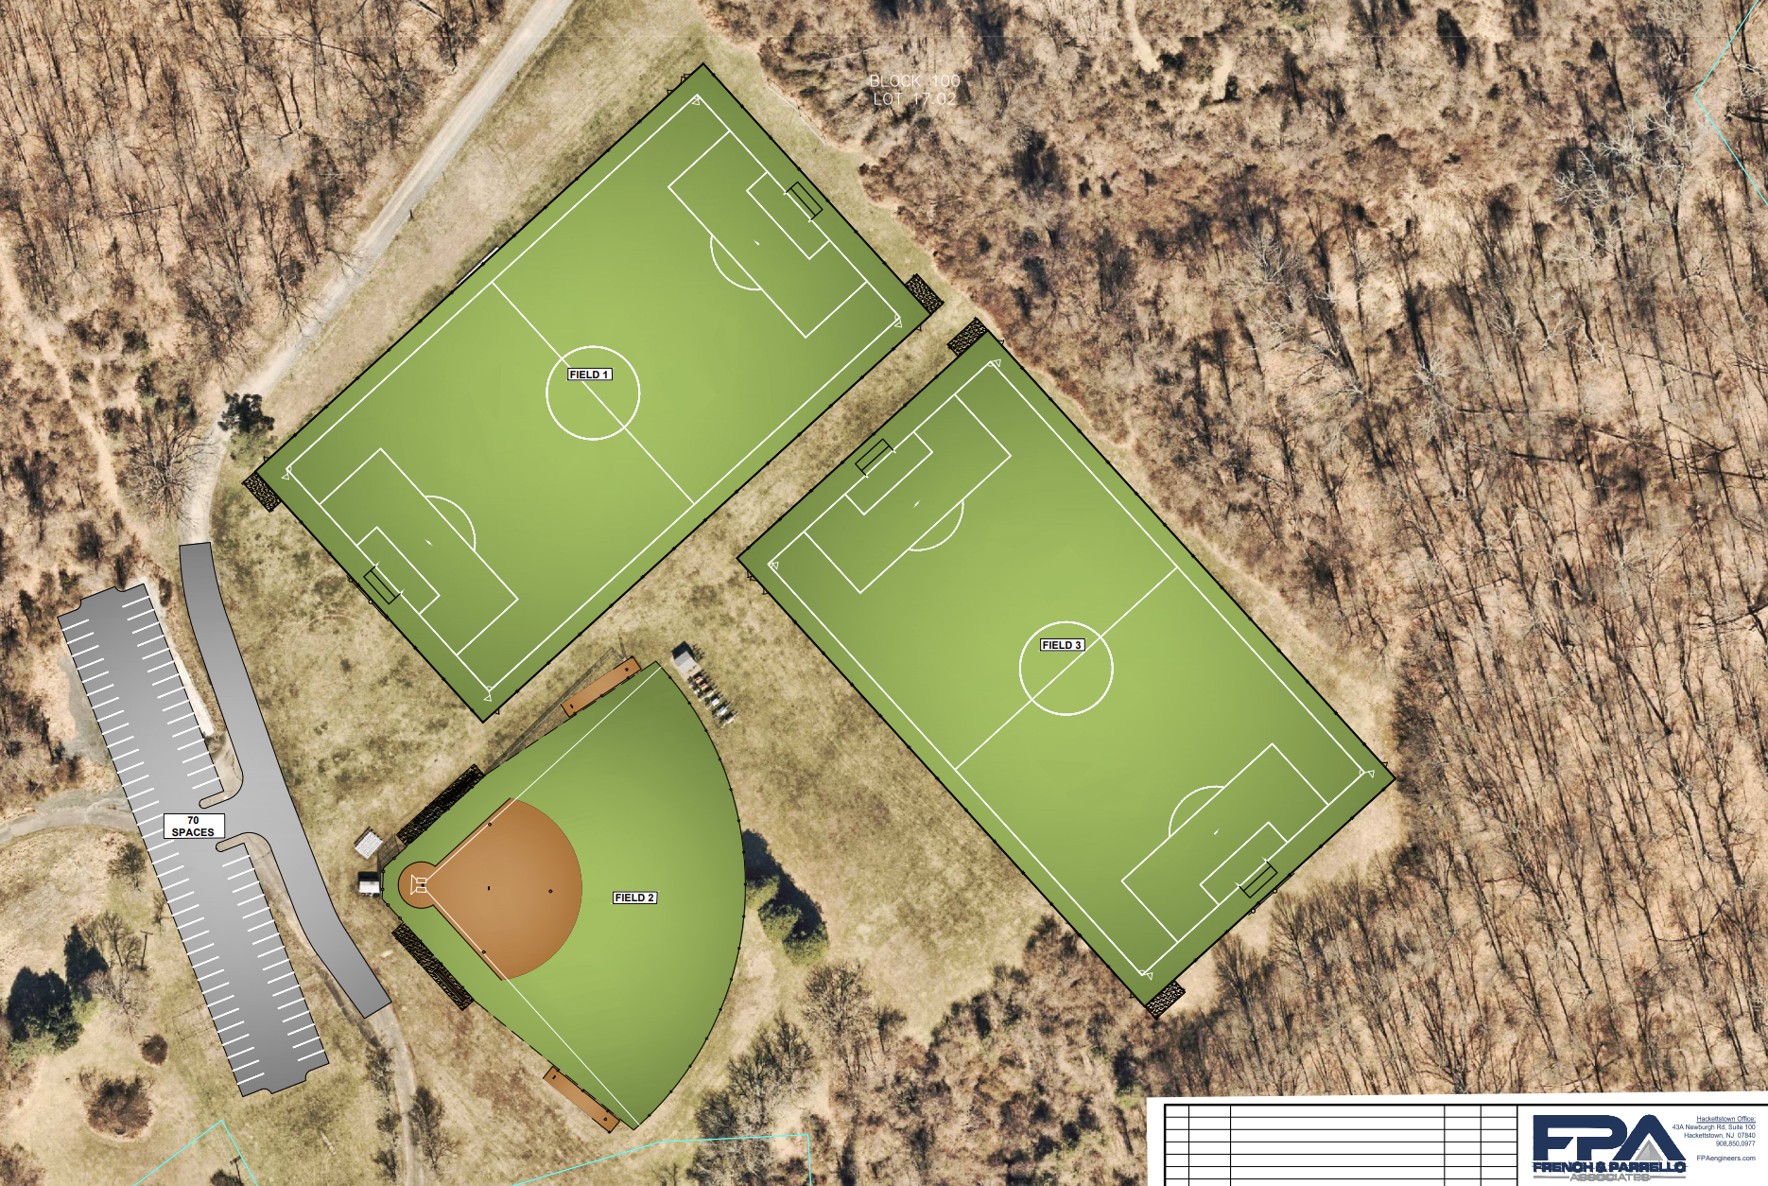
1 - Football
3- Multi Purpose
2- Baseball

Slide 5
Proposal – From Engineer
Base Proposal
Electrical Service – $40,000
Parking Lot Lights – $140,000
Football Field
Field Improvements – $305,650
Lights – $420,000
Turf - $1,303,650
Baseball Field
Field Improvements - $129,800
Lights - $280,000
Multi Purpose Field
Field Improvements – $306,650
Lights - $450,000
New Parking Lot
$414,000

Slide 6
Discussions with Sports Leagues

Slide 7
Recreation Committee Proposal (Highlighted)
Base Proposal
Electrical Service – $20,000
Parking Lot Lights – $140,000
Football Field
Lighting – $420,000
Field Improvements – $305,650
Baseball Field
Field Improvements - $129,800
Lights - $280,000
Multi Purpose Field
Field Improvements – $306,650
Lights - $450,000
New Parking Lot
$414,000

Slide 8
Recreation Committee Proposal
$180,000
100% Township Responsibility
Base Proposal
Electrical Service – $40,000
Parking Lot Lights – $140,000
$700,000
50% Township Responsibility and 50% Sports Leagues Responsibility/Fundraising
Football Field
Lighting – $420,000
Baseball Field
Lights - $280,000

Slide 9
Finances – Lights
Total Project Cost: 700,000
Down Payment: $35,000
Issued Debt: $665,000
Interest Rate: 3.500% over 10 years
Debt payments between 70,000 and 80,000 per year to be split
50% by Township
50% by Sports Leagues

Slide 10
Finances – Parking Lot
Total Project Cost: 180,000
Down Payment: $9,000
Issued Debt: $171,000
Interest Rate: 3.500% over 10 years
Debt payments approximately $20,000 per year

Slide 11
Traffic Impact
Possibility to have a Baseball and Football Game at the same time.
These will have to be scheduled and approved
We will attempt to minimize overlap
Currently there is a baseball field and football field – field capacity is not being increased
Plan to have gaps between practices and games; as well as a staggered schedule
Baseball:
20-25 cars max per game
18-20 cars average per game
Football:
40 cars max per game
30 cars average per game

Slide 12
Environmental
We are looking into the possibility of having the lights powered by Solar
Regardless of solar installation, lights are still being used.
Currently 8-10 Diesel Powered light towers are being used up to three times per week for hours.

