Slide 1
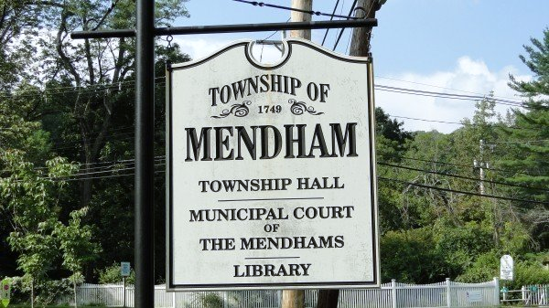
Mendham Township Master Plan
presentation
June 29, 2022
Notes:
History of this project the project kicked off May 27 2020 several subcommittee meetings in June and July and September and the plan is in its final draft form and we like to go through some of the highlights and ask for any additional feedback that you may have as a board prior to the formal public hearing to be scheduled.
Township last updated its plan in 2002 and the last nitrate dilution study was completed in 1996
Comparatively speaking when you consider the changes in adjacent municipalities Mendham has not had significant changes and one of the main objectives carried forward which has been successfully implemented is the preservation of it’s rural/historical character.

Slide 2
Purpose of Master Plan
Identify current planning issues and changes
1
Update recommendations based on changes and new issues
2
Integrate updated Nitrate Dilution Model done in 2020
3
Notes:
Understanding the development trends in Mendham, the impacts and recent development of the past few years
Understand the needs of and issues and identify opportunities and recommendations based on an integration of nitrate dilution modeling and a build out based on the similar principals and sustainable growth

Slide 3
INTENT OF PROCESS
The Master Plan is a guiding document for multi-disciplinary planning and investment in the Township of Mendham for the next 10+ years.
The 2021 Master Plan written with the intent of “exploring opportunities for changes to current zoning regulations that would provide for development at sustainable densities while maintaining the existing community character”.

Slide 4
MASTER PLAN TIMELINE
Mendham’s last Master Plan adopted in 2002.
The Master Plan was re-examined in 2008 and 2018.
2018 Master Plan Re-Examination Report recommended an updated Land Use Plan based on an updated Nitrate Dilution Model.

Slide 5
Significant Changes
Demographic changes
Smaller households
Older population
Housing market and demand changes
Decline in the desire for very large residential lots
Residential development in Mendham far lower since the previous Master Plan compared to before
Updated Nitrate Dilution Model
Nitrate Dilution Model estimates that the Township can sustainably accommodate more households compared to previous model.
COVID-19
Widespread adoption of remote work & hybrid working
Movement of residents from urban areas to suburban areas
Stormwater requirements
Updated NJDEP stormwater management rules adopted by the Township in 2021.
Notes:
Since 2002

Slide 6
Demographic Changes
Mendham Township Population Forecasts
Year | Population | Change | Percent
2000 | 5,400 | -- | --
2010 | 5,869 | 469 | 8.7%
2020 | 6,016 | 147 | 2.5%
2045 | 6,310 | 294 | 4.9%
Mendham’s estimated population has seen a slight increase, albeit at a much slower pace compared to previous decades
County’s population increased by 3.5% during same time period
Mendham’s population is much older compared to County and State population
NJTPA Plan 2045 Forecasts by County and Municipality, 2015-2045

Slide 7
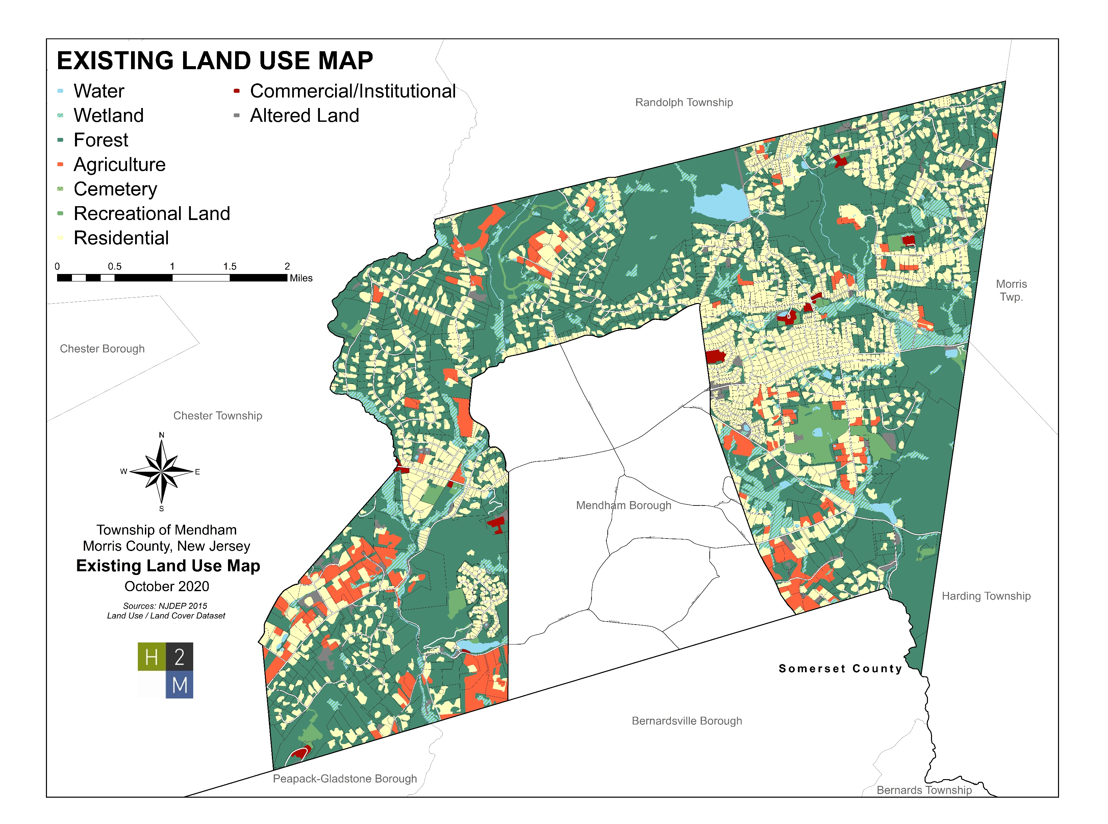
Existing Land Use
Predominantly low-density residential
Large areas of forests
Significant areas of farmland
Some wetlands

Slide 8
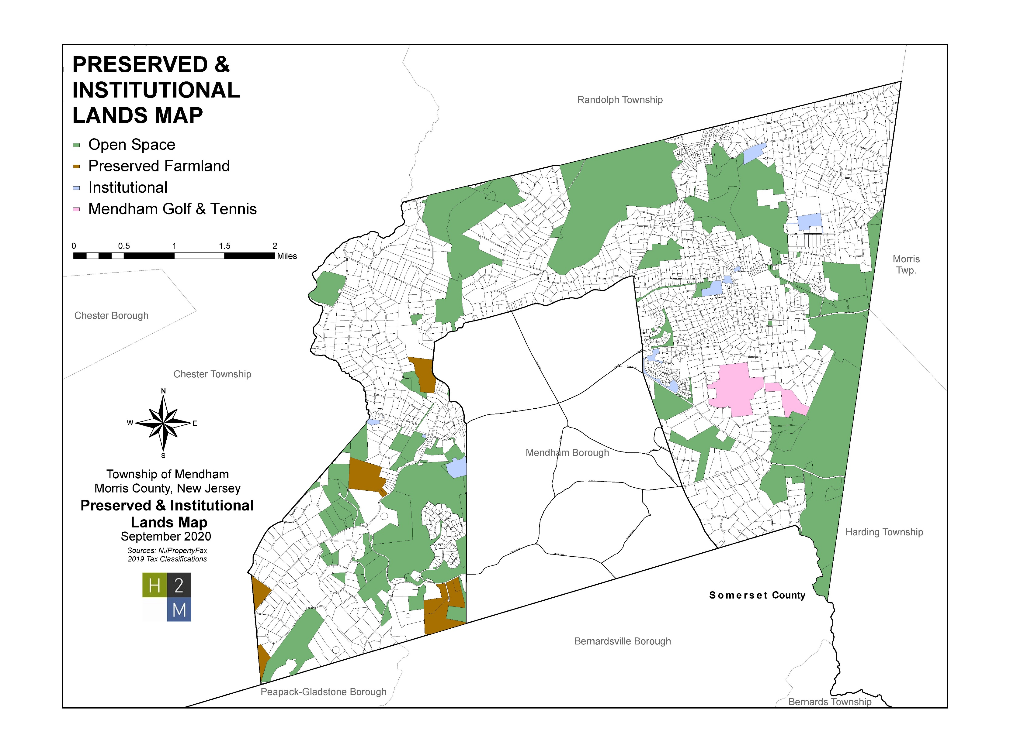
Preserved & Institutional Lands
Open Space
Lewis Morris Park
Schiff
Dismal Harmony
Clyde Potts
Preserved Farmland
Institutional Uses

Slide 9
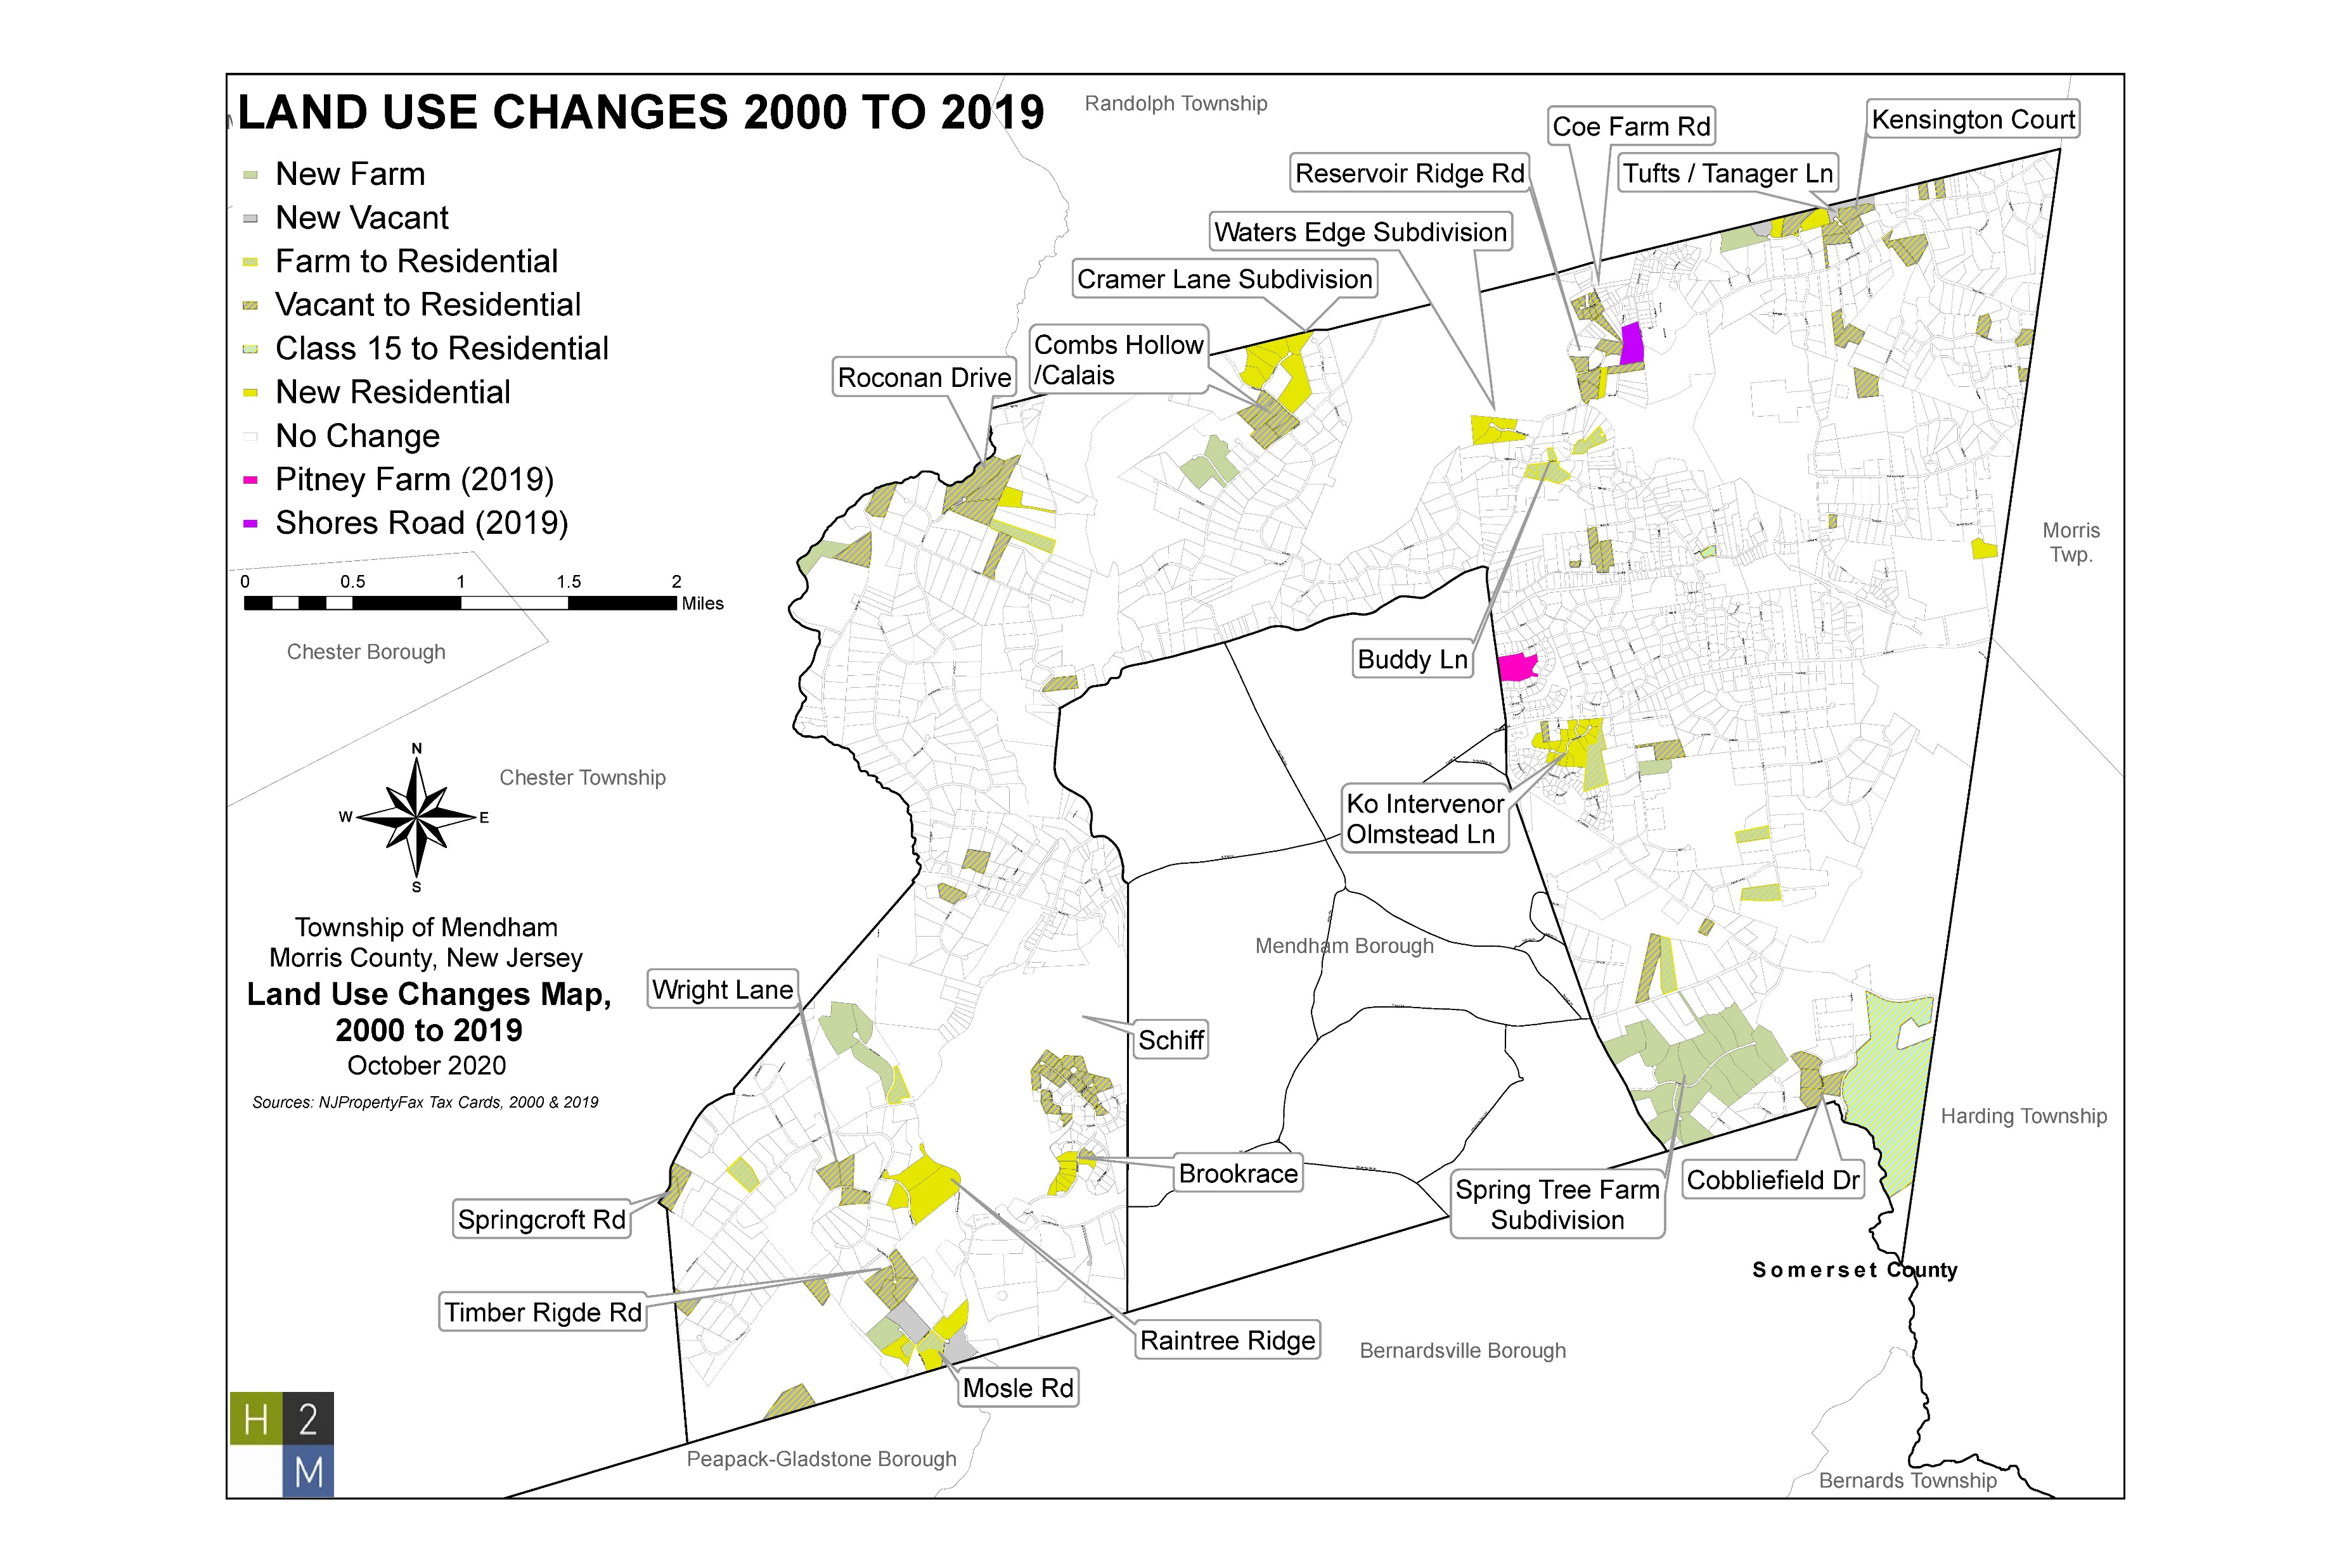
Land Use Changes
Recent Changes:
Pitney Farms
Shores Road
Spring Tree Farm
Notes:
The plan goes into greater detail on describing and characterizing the different areas in the township to appropriately understand the land use in the town

Slide 10
Development Trends
Since 2005:
233 building permits for additions issued
Township has had a net gain of 30 housing units
Single-family homes have seen as many demolition permits as C.O.s
However, fall out from Covid-19 pandemic may reverse trend in housing market due to changing preferences
Notes:
At the height of the housing market in 2008 before the recession the Township hit it’s peak of 23 building permits which again by way of comparison is significantly lower that adjacent municipalities including chester and morris townships
There has been a significant and evident drop off over the last few years with a minor uptick partial in response to the mass exoduses out of the city in 2020 due to covid the demand for more rural living is something that in the post covid world will remain a reality and communities in western morris county are especially desirable due to there amazing amenities and schools.

Slide 11
Nitrate Dilution Model
Optimal land area per household needed to meet State standard:
3.7 to 3.9 acres
Sustainable population and households based on solely septic use:
Population range: 5,893.6 to 8,044.7 people
Household range: 1,961.9 to 2,678.0 households

Slide 12
Further Breakdown of NDM
Projections Estimates for Sustainable Growth, by Zone
Zone | Projected New Lots | Sustainable number of Homes in zone, 2.0mg/L threshold | Environmental Constraint Adjustment* | Adjusted Sustainable Additional Number of Homes | H2M current estimate of homes in Zone | Total Projected Lots
B-Zone | 0 | 1 | 0.0% | 0 | 1 | 1
CR-1 Zone | 0 | 106 | 0.0% | 0 | 99 | 99
CR-2 Zone | 0 | 33 | 0.0% | 0 | 155 | 155
R Zone | 88 | 42 | 35.0% | 15 | 199 | 214
R-1 Zone | 47 | 121 | 15.7% | 19 | 342 | 361
R-2 Zone | 20 | 108 | 19.4% | 21 | 201 | 222
R-3 Zone | 82 | 529 | 23.0% | 122 | 534 | 656
R-5 Zone | 41 | 677 | 8.6% | 58 | 432 | 490
R-10 Zone | 3 | 1021 | 2.8% | 29 | 114 | 143
Total: | 281 | 2638 | 9.4% | 264 | 2077 | 2341
Adjustments based on existing lots and environmental constraints
*Environmental Constraint Adjustment is based on the percentage of land area in each zone that can be developed given current zoning and existing environmental constraints

Slide 13
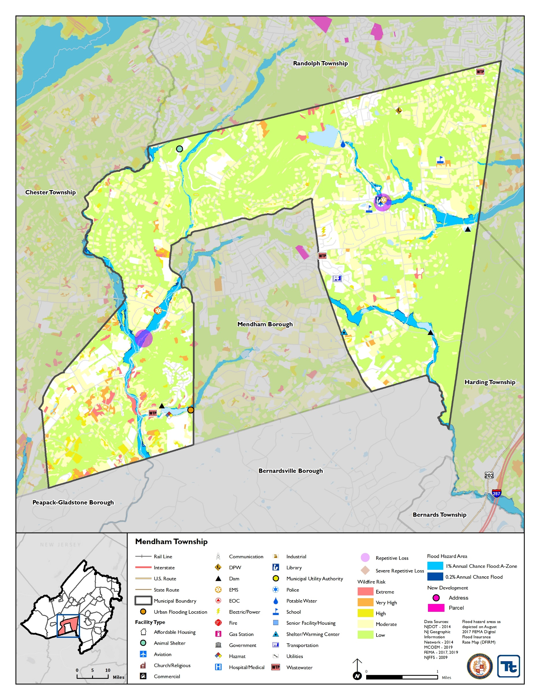
Resiliency and Environmental Sustainability
Flooding Concerns:
Whippany, Passaic and northern branch of Raritan River flood plains
Repeated flooding of police department building
Other public and semi-public properties located in flood plain
Energy Supply Concerns
Need for additional backup generators
Updated Stormwater Management Ordinance

Slide 14
Significant Land Use Considerations
Roadscape Preservation- Key to rural historic character and sense of place
Historic Preservation- Paramount to the architectural and historical integrity of the Township
Water Quality and Environmentally Sensitive Land Protection- Crucial to understanding capacity for development

Slide 15
Overarching Land Use Recommendations
Regulate future development to overall very low densities
Future development should relate to findings of 2020 NDM and CPCM Report
Encourage creative and flexible zoning and development techniques that balance future development with land conservation
Allow for accessory dwelling units, including accessory cottages, and other aging-in-place policies

Slide 16
General Land Use and Zoning Recommendations
Conduct analysis to identify parcels near zone district boundaries that may warrant consideration for rezoning.
Promote Preservation especially along roadways
Promote visual resources like scenic vistas and historic roadways
Contemplate more flexible standards such as clustering to allow for development that is consistent with the pattern or form of historic development.

Slide 17
Housing Plan Recommendations
Meet the change in housing preferences due to Covid-19 pandemic
Adopt aging-in-place policies to allow for older residences to continue living in the community
Amend the current accessory apartment ordinance to expand housing options in the Township

