Slide 1
Partnering with the New Jersey Highlands Council
Mendham Township Council
October 24, 2022

Slide 2
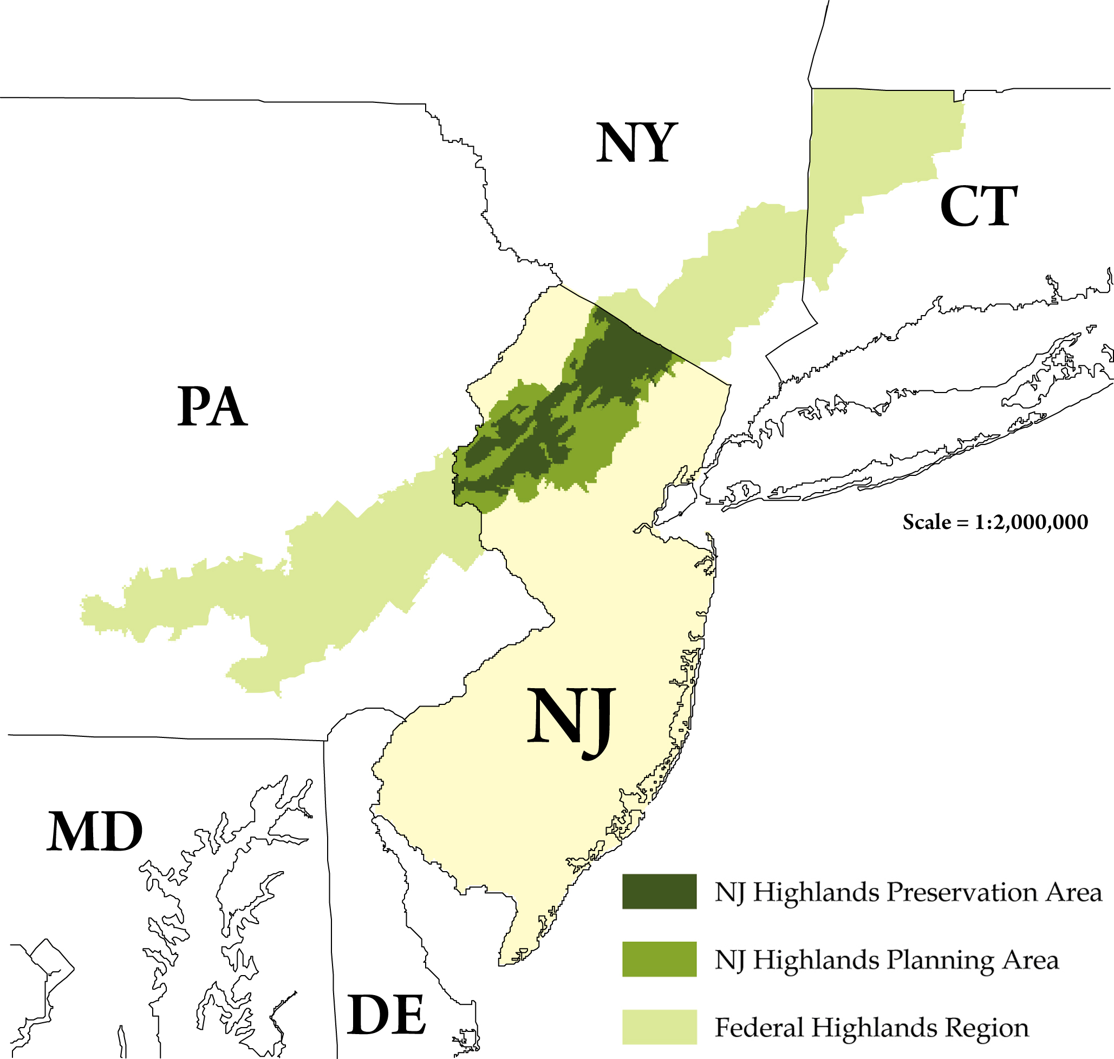
Federal Highlands Region
Highlands Conservation Act
“…to recognize the importance of the water, forest, agricultural, wildlife, recreational, and cultural resources of the Highlands region, and the national significance of the Highlands region to the United States.”
PA

Slide 3
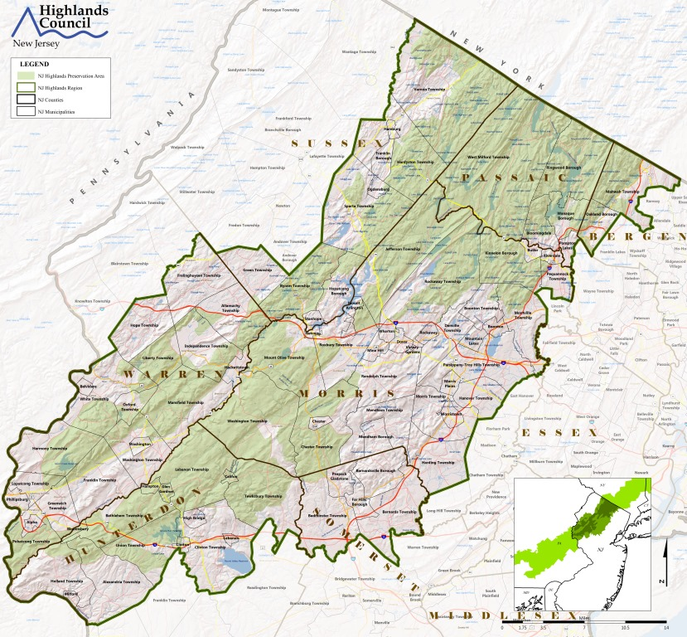
New Jersey Highlands Region
88 municipalities; parts of 7 counties.
The New Jersey Highlands Water Protection and Planning Act: “…the protection of the New Jersey Highlands, because of its vital link to the future of the State's drinking water supplies and other key natural resources, is an issue of State level importance that cannot be left to the uncoordinated land use decisions of 88 municipalities, seven counties, and a myriad of private landowners…”

Slide 4
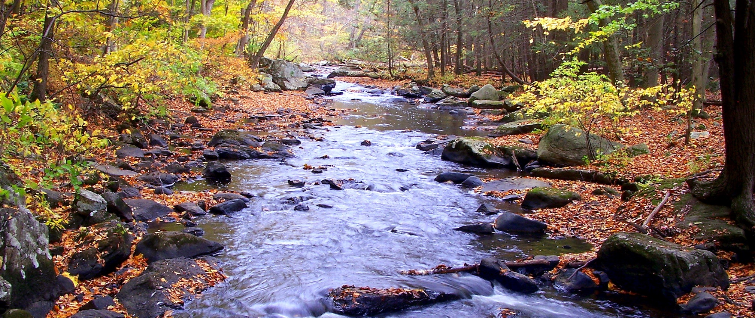
Since watersheds and other natural resources do not follow municipal boundaries, a regional planning approach is required to protect them.

Slide 5
Regional Planning
Highlands Act directed a regional approach to land use planning.
Since watersheds and other natural resources do not follow municipal boundaries, a regional planning approach is required to protect them.
Other examples of regional planning in NJ
Hackensack Meadowlands Commission and Master Plan
Pinelands Commission and Comprehensive Management Plan

Slide 6
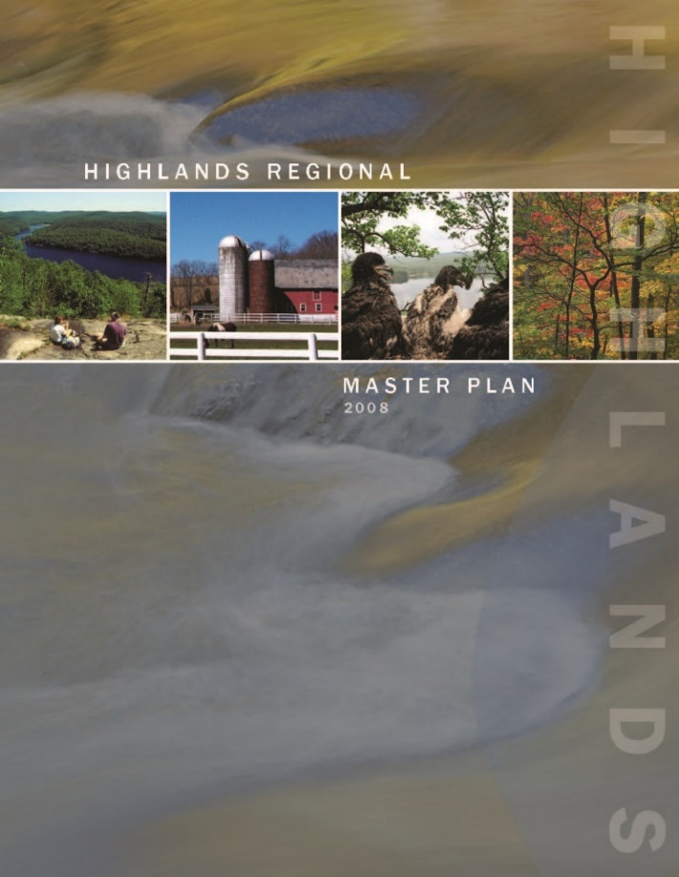
Regional Master Plan (RMP)
The RMP is structured around the following planning considerations:
Natural Resources
Water Resources
Agricultural Resources
Historic, Cultural, Archaeological, and Scenic Resources
Transportation
Landowner Equity
Sustainable Economic Development
Air Quality
For each of these areas, the RMP provides a regional analysis, identifies Goals, Policies, and Objectives (GPOs) and defines programs to implement the GPOs.

Slide 7
Highlands Council Grant Program
Established by the Highlands Act to pay for the “reasonable expenses” associated with implementation of the Act
Reimbursement based
No match required
Eligible applicants: Highlands municipal and county governments
Eligible expenses: planning, design and engineering costs
Requires Highlands Council staff approved Scope of Work

Slide 8
Grant Funding Available
Historic Preservation Planning and Cultural Resource Inventory
Green Building and Environmental Sustainability Planning
Water Quality Monitoring
Alternative Wastewater Planning
Highlands Center Planning
Lake Management Planning
Water Use and Conservation Management Planning
Land Preservation & Stewardship Plan
Trails and Recreation Planning
Habitat Conservation & Management Planning
Municipal Master Plan Reexamination and Updates
Stormwater Management Planning
Scenic Resource Management Planning
Forest Stewardship Planning
Sustainable Economic Development Planning
Stream Corridor Protection/Restoration Planning

Slide 9
Examples of funded projects
Municipal-wide Lake Management Study $175,525
Rockaway Township Morris County
Open Space & Trails Plan $94,000 Parsippany-Troy Hills Township
Morris County
Groundwater Recharge Enhancement Project $85,000
Montville Township Morris County
Critical Habitat Conservation Management Plan
$50,000
Kinnelon Borough
Morris County
Build-out Analysis
$10,000
Boonton Township
Morris County
Municipal Beach and Watershed Restoration Plan
$60,000
Mount Arlington Borough
Morris County
Open Space & Recreation Plan
$12,000
Kinnelon Borough
Morris County
Municipal-wide Drainage Study
$160,000
Wharton Borough Morris County

Slide 10
Why work with the Highlands Council?
Advance municipal planning vision
Direct growth to areas most appropriate for growth
Protect and enhance open spaces and natural resources
Address transportation challenges
Improve stormwater management (reduce flooding)
Collaborative process, driven by municipal needs.
Mendham Township’s goals are also Highlands Council goals.

Slide 11
RMP Considerations for Mendham Township
Entire Township in Planning Area of Highlands Region; working with Highlands Council is voluntary.
Revisions to land use and resource management planning documents as appropriate to align with the Act and RMP
Township retains all local enforcement and regulatory control.
Goal is resource protection and sustainable growth
through good planning.

Slide 12
Affordable Housing Considerations
Highlands Act requires the Regional Master Plan be taken into consideration when determining fair share housing needs.
Municipalities need to adopt a housing element and fair share plan.
Highlands Council grant funding:
Development of Housing Element and Fair Share Plans
Build out analysis to inform vacant land and durational adjustments
Mid-point reviews

Slide 13
Potential Next Steps
Initial Assessment (IA) Report
Grant funds to complete IA Report
No obligation to proceed beyond
Continue conversation according to Township’s wishes

Slide 14
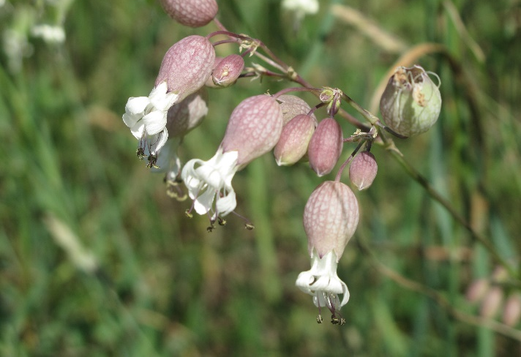
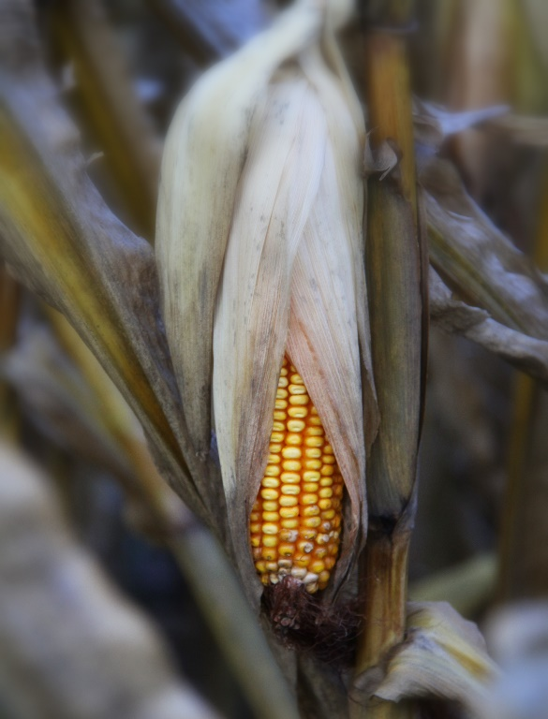
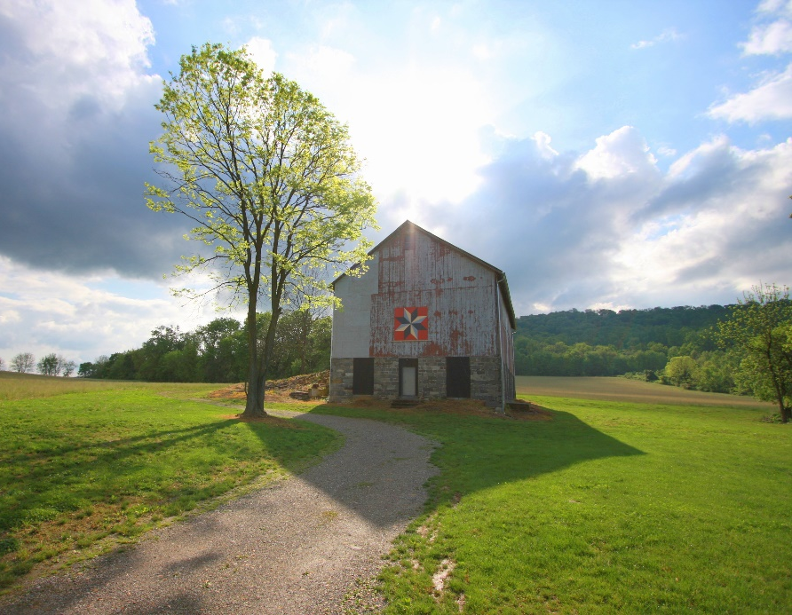
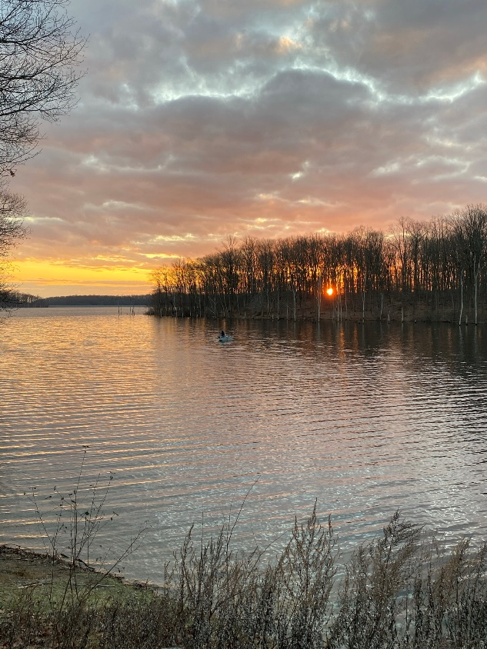
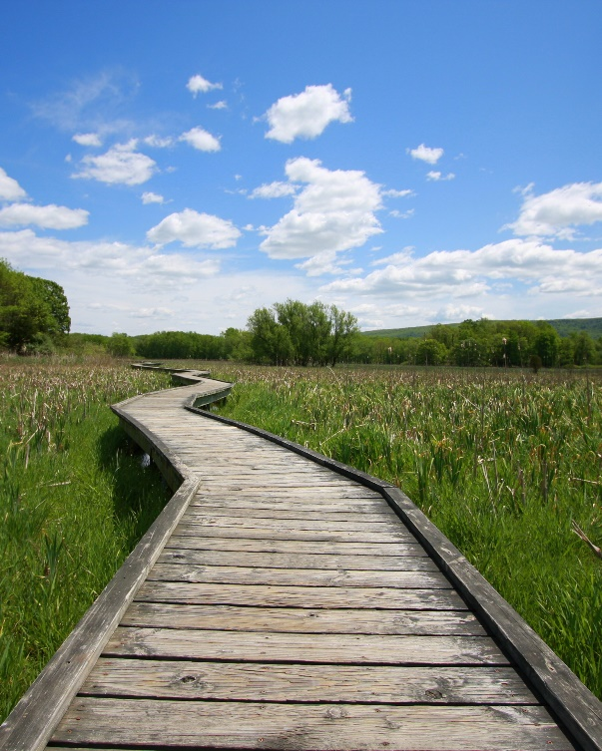
Questions?

