Slide 2
1-973-476-2956
FOUNDED MAY OF 2022
23 Tingley Rd. Mendham Township, NJ 07960

Slide 3
MISSION
Our mission is to partner with Mendham Township and other private and public woodland landowners to sustainably farm a wide variety of native mushrooms to help restore our New Jersey forests to their former native resilient state. With community involvement, our efforts can raise awareness while helping to address ecological issue such deforestation, carbon capture, blights and invasive species, while simultaneously creating healthy agricultural products.
TEST AND DEVELOP SUSTAINABLE WOODLAND FARMING TECHNIQUES

Slide 4
INTRO
Create a P3 agreement with the Mendham Township to reforest and maintain key woodland lots using the woodland agricultural techniques that we are developing for North Jersey woodlands. We plan on getting the support of the USDA, NRCS and NJDEP. We believe that this might also help MT get grants from NJ DEP RGGI program.
Start with two or three lots for expediency and trial purposes and look at expanding later with legal approval to other preserved or un preserved lots owned by MT.
Within the P3 agreement would be a 10 year lease for custodial and woodland agriculture purposes only. The terms of the agreement would make MM responsible for woodland restoration, trail building and all maintenance on the property.
Create a hands-on educational program for residents to practice woodland restoration and preservation on their own private property

Slide 5
PROBLEM DEFINITION
NJ native hardwood woodlands were almost completely wiped out during the 18th and 19th centuries due to lumber harvesting and farming. Later in the 20th century by urban sprawl. The mycorrhizal fungal colonies in our soil were also all but wiped out. During the last 130 years new tree species have spread in the void left by the old traditional oak, hickory, chestnut stands that were killed. The mycorrhizal fungal colonies have not materially returned in their previous composition. Generalist Mycorrhizae have replaced the specialist varieties that evolved with the larger slow growing Hardwood trees. White ash is a relatively fast growing hardwood that filled a large part of the void left by the harvested slower growing hardwoods, but even that tree species is subject to an insect blight.
The loss of these fungal colonies left our existing and new forests exposed to blights and the unchecked spread of various fungus and soil bacteria which are not beneficial in quantity to our woodland. Such as oak wilt, Dutch elm disease, chestnut blight, North Shelf and many others. It also caused the acceleration of ground litter decomposition allowing a faster spread of invasive plants like Rosa Multiflora, Barberry and others. Recent science has identified that Mycorrhizal Fungi in their exchange of nutrients with their Symbiont tree partners, provide not just phosphates, minerals and nitrates to the tree but also complex chemical compounds to fight off; invasive insects (insecticides), parasitic fungi and even help make bark fire retardant. Mycorrhizal fungi also help feed saplings with Nutrients from the parent tree to enhance establishment of new trees. Without this network in the soil and its chemical production our woodland forests are more vulnerable.
Simply Preserving the land and setting it aside doesn’t fully protect the woodland environment in fact those practices alone here in North Jersey are changing the profile of our forests in many ways. Besides making our woodlands more susceptible to blights and diseases, it is replacing the historic woodland eco system with new forest that does not support, as well, traditional fragile historic flora, fauna and fungal populations. This is due to the introduction of so many new species of trees, plants and fungi over the last 130 years.

Slide 6
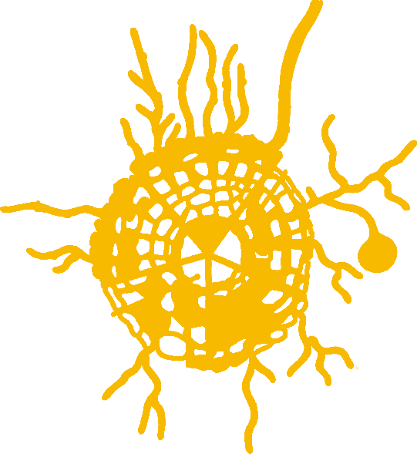
REFORESTATION SOLUTION
REFORESTATION ENTAILS A LOT MORE THAN PLANTING TREES. IT MUST TAKE INTO ACCOUNT THE FOLLOWING;
1.
Planting Native Hardwood trees
2.
Soil Health Bacterial content
3.
Soil Health C:N ratios
4.
Invasive plant removal
5.
Thinning fast growing
softwood tree stands
6.
Soil Health pH
7.
Soil Health Mycorrhizal Fungal colonization
Lots that have been cleared need all of these activities (1-7) to properly restore the woodland forests.
Newly forested lots will require activities (4-7) to properly restore the woodland forests.

Slide 7
BENEFITS (1)
Almost all land plants form symbiotic associations with mycorrhizal fungi. These below-ground fungi play a key role in terrestrial ecosystems as they regulate nutrient and carbon cycles, and influence soil structure and ecosystem multifunctionality. Up to 80% of plant N and P is provided by mycorrhizal fungi while Mycorrhizal fungi increase plant carbon capture and use by 20-30%. Many plant species depend on these symbionts for growth and survival. Estimates suggest that there are over c. 50 000 fungal species that form mycorrhizal associations with more than c. 250 000 plant species which includes all 6000 species of trees.
Carbon and nutrients can be transferred from one plant to another through fungal hyphae. In boreal forests, mature trees allocate significant amounts of Carbon into mycorrhizal networks.

Slide 8
BENEFITS (2)
Mycorrhizal networks are important for seedling establishment in perennial vegetation ^{[1] [2]}. Small seedlings then have immediate access to a low-cost ‘nutrient adsorption machine’, provided and maintained by the surrounding vegetation ^{[3]}.
Plants investing the largest amount of C into mycorrhizal networks often obtain the largest amount of nutrients in return, indicating that resource exchange is, at least to some extent, controlled ^{[4][5]}.
AM symbiosis is considered ancestral among land plants, and it probably allowed their transition from water to land 470 Million years ago ^{[6]}. Ectomycorrhizal associations are much younger than the AM symbiosis and evolved c. 100–200 million year ago during a period of rapid angiosperm radiation in the Jurassic and Cretaceous ^{[7]}. EM interaction networks display an intermediate structure, showing modularity and nestedness ^{[8]}, with generalist EM fungal species having a broad host range, colonizing many trees in a forest, and more specialized EM fungi associating with particular hosts
Notes:
ggg

Slide 9
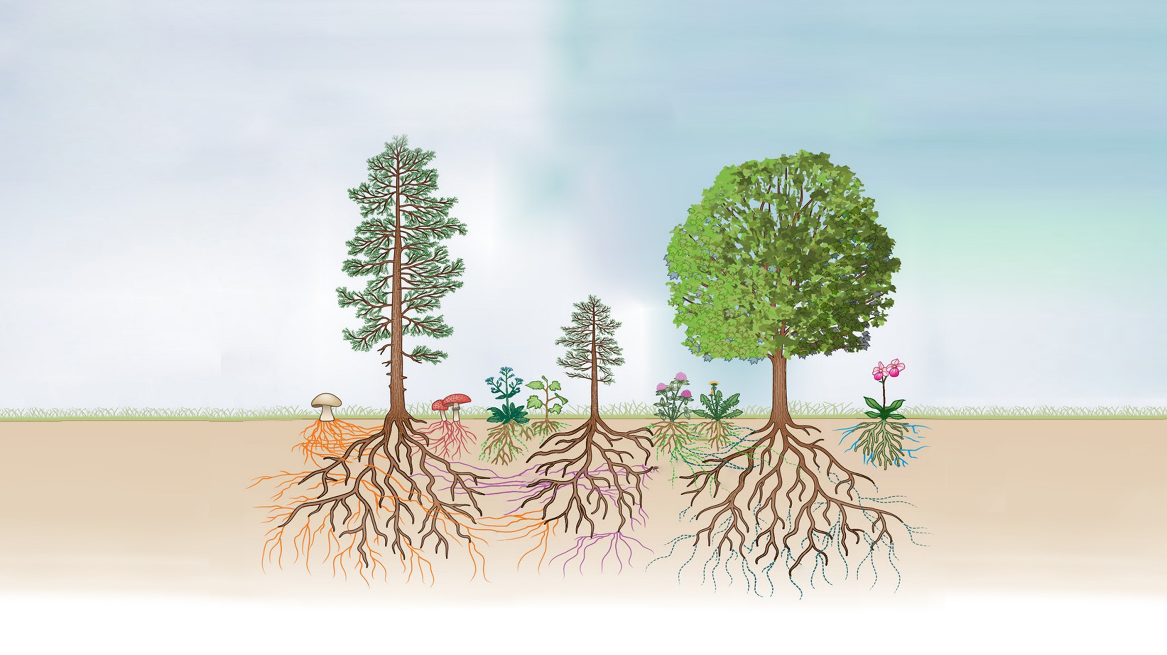
CO
2

Slide 10
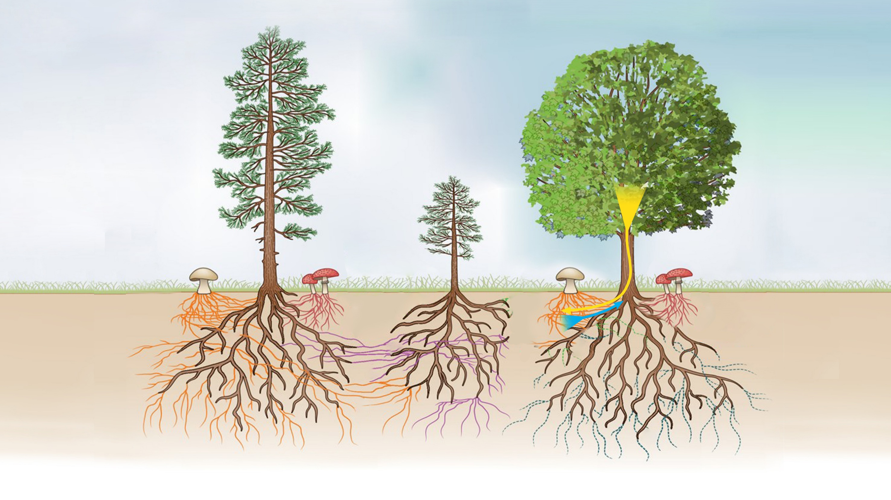
Extreme Temperature Resistance
Disease and Insect Resistance
Drought Resistance
Photosynthesis Products
(Carbohydrates)
Heavy Metal Resistance
Water and Mineral Nutrients

Slide 11
PROPOSAL
Enter into a PPP agreement between Mendham Township and Mendham Mushrooms with the following objectives;
Set up a trial by leasing two or three lots of Township owned land for reforestation and forest maintenance
Collect Soil and VFS data for NJDEP
Agree to resilient native reforestation objectives for each lot
Coordinate with the Mendham Township forestry plan
Execute agreements by Sept 22, 2022

Slide 12
PROPOSAL OPTIONS (1)
IF AGREEMENTS CAN BE REACHED BY SEPT 23RD SEVERAL OPTIONS WILL ALSO BE AVAILABLE;
1
Mendham Mushrooms would establish a reforestation and mycology conservation facility at one of the approved/leased lots.
2
Mendham Mushrooms would create a public education curriculum in conjunction with the environmental Commission for Mendham residents on woodland restoration and growing edible mushrooms on your private property
3
Mendham Mushrooms would engage Rutgers University to engage in a more scaled and comprehensive study of the Woodlands of Mendham Township for woodland restoration options beyond the trial.

Slide 13
PROPOSAL OPTIONS (2)
IF AGREEMENTS CAN BE REACHED BY SEPT 23RD SEVERAL OPTIONS WILL ALSO BE AVAILABLE;
4
Mendham Mushrooms would conduct a Carbon Capture analysis annually and soil condition analysis annually for the Township.
5
If the Trial is successful according to the USDA, Mendham Township at their option could expand the PPP agreement to whatever properties in the Township determined to be beneficial to the public good.
6
Create profit sharing clause in years 4-10 to fund other ecological initiatives

Slide 14
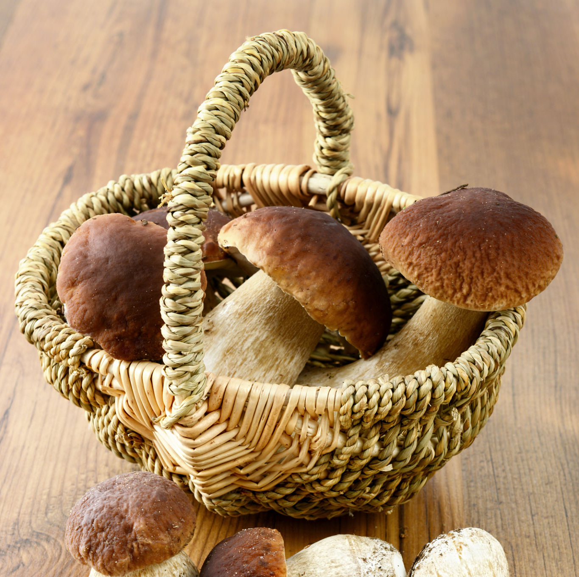
SUPPORT
Involve the Environmental Commission In planning, site selection and educational objectives
Solicit scout troops, high school students or town volunteers to do tree inventories and initial soil samples
Monthly educational trial hikes.

Slide 15
NEXT STEPS
1.
Get township approval to proceed with a limited Pilot project
2.
Identify lots and collect VFS data
3.
Draft, approve and execute PPP agreement
4.
NJDEP RGGI grant for Mendham Township
(optional)
5.
USDA CSP and SHD grants for Mendham Mushrooms

Slide 16
APPENDEX
[1] Grime et al., 1987
[2] van der Heijden & Horton, 2009
[3] Newman 1988
[4] Kytoviita et al., 2003
[5] Kiers et al., 2011
[6] Selosse & Le Tacon, 1998
[7] Brundrett, 2002
[8] Bahram et al., 2014

